Slide 1
CAD and 3D printing
Tamas Ungi, Andras Lasso

Slide 2
Whey learn CAD and 3D printing?
Make small tools (stylus, sim ultrasound, etc.)
Make sensor attachments
Make phantoms (anatomical, calibration)
Reproducible (share models, calibrate once)
Good printers under $250
Material cost ~$0.3 /g
Lots of fun!

Slide 3
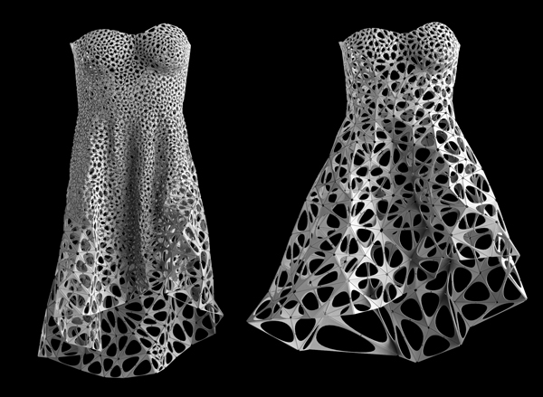
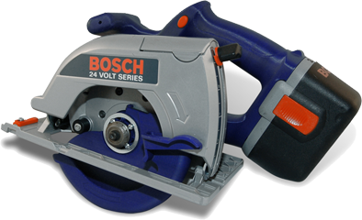
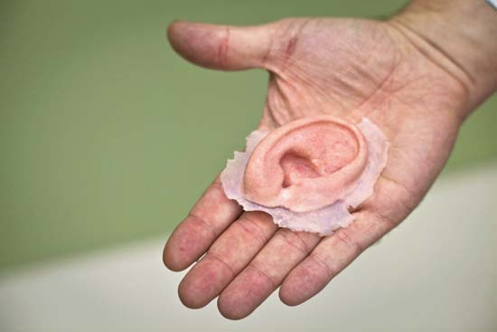
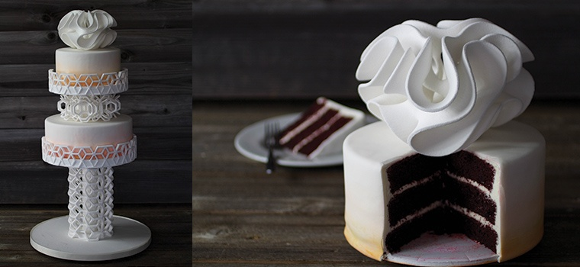
1980s Presentation models, functional models…
http://n-e-r-v-o-u-s.com/blog/?p=4467
http://www.stratasys.com
http://media-2.web.britannica.com
… jewelry, clothes, toys, food...
http://www.3dsystems.com/es/chefjet

Slide 4
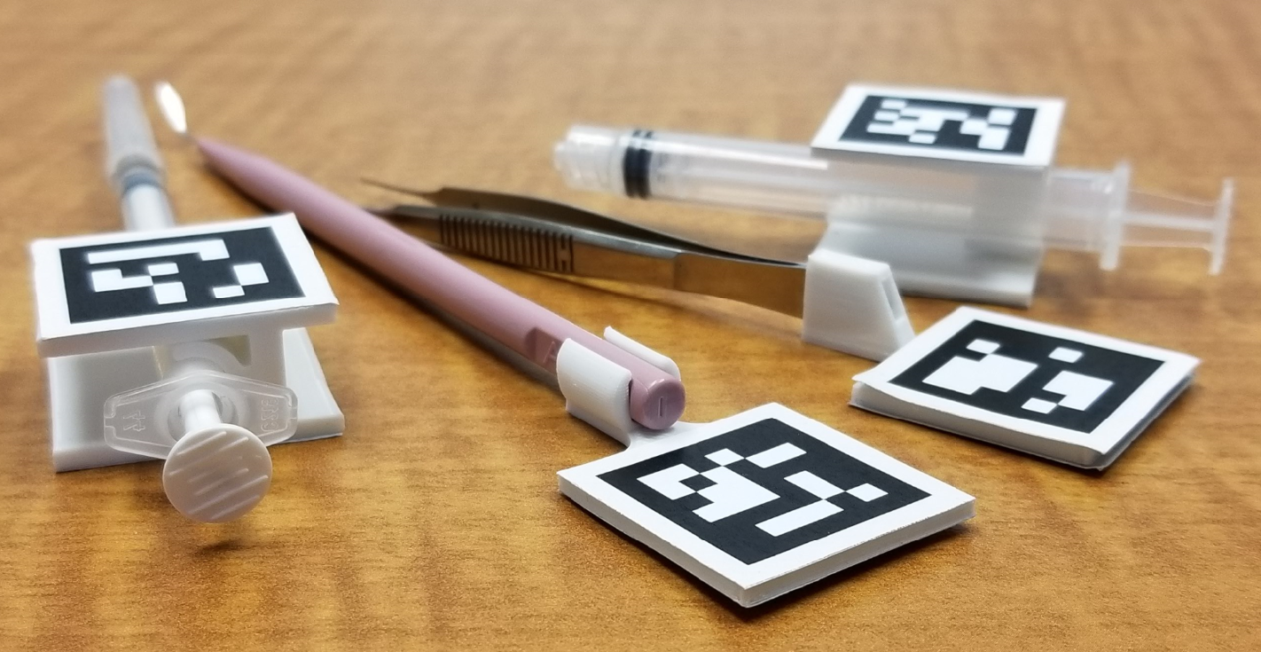

Slide 5
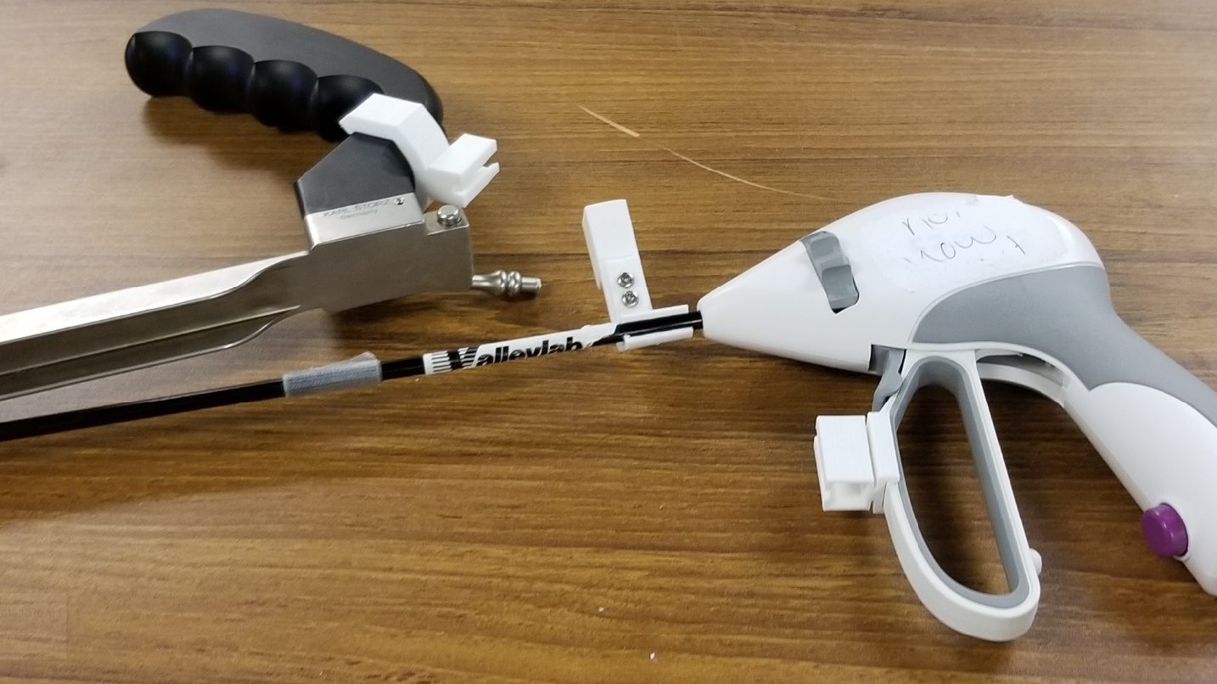

Slide 6
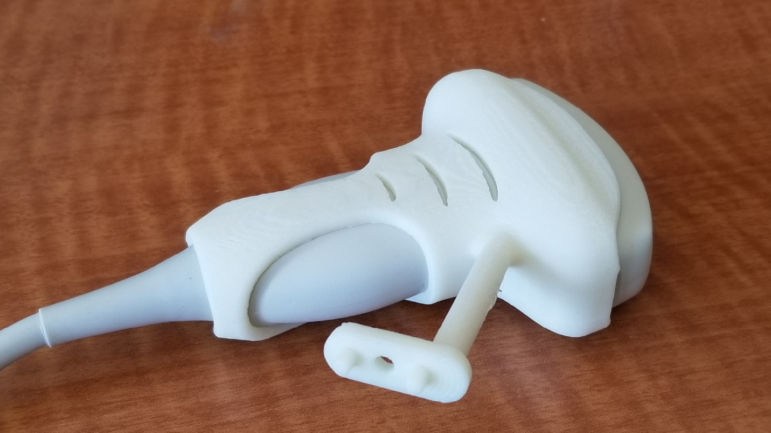

Slide 7
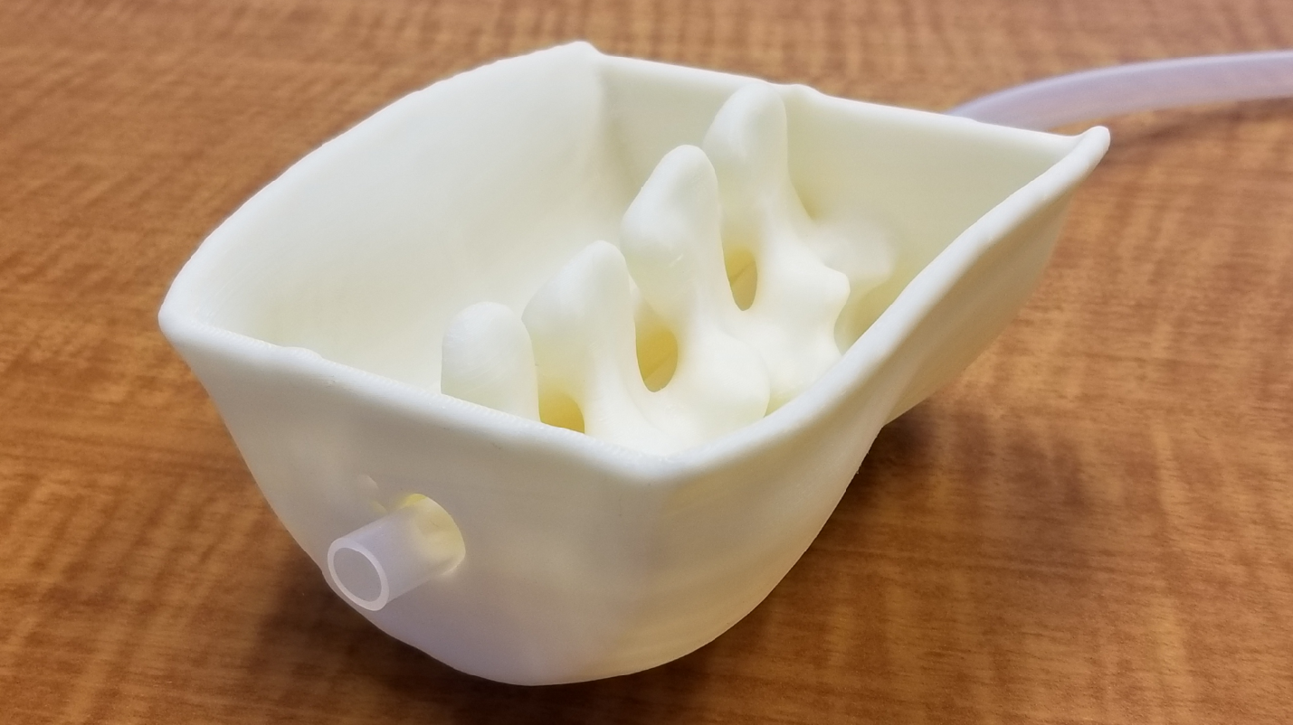

Slide 8
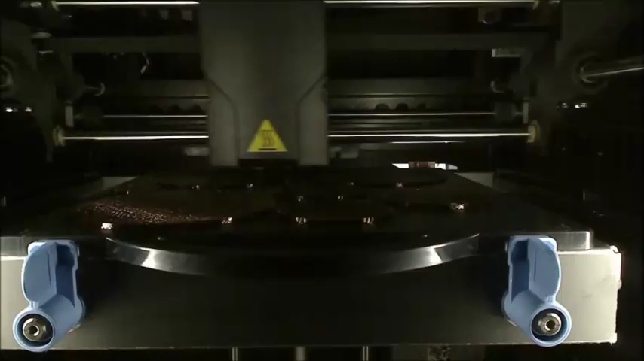
3D printing process
Model preparation:
Slice model into thin planes
Add support structure
Determine filling patterns
Print the model layer by layer
Finishing:
Dissolve/remove support material
Curing
Sanding, filing
Coating, polishing

Slide 9
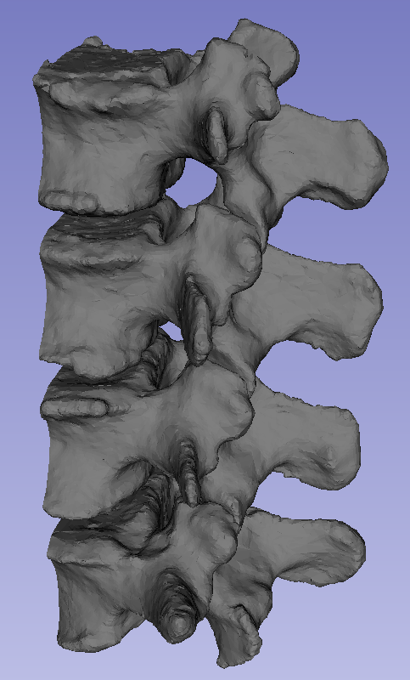
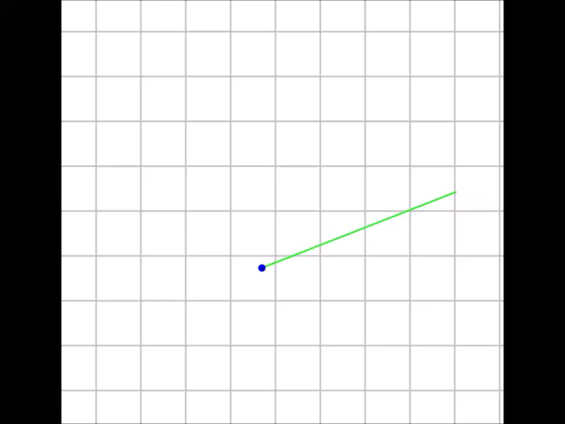
Slic3r - gcode generator

Slide 10
Most common materials
 | ABS (acrylonitrile butadiene styrene) | PLA (polylactic acid)
Tensile strength | 27 MPa | 37 MPa
Elongation | 4 - 40% | 6%
Density | 1.0 - 1.4 g/cc | 1.3 g / cc
Melting point | 105 C - glass transition 230 C - extrusion | 60 C - glass transition 190 C - extrusion
Biodegradable | No | Yes (48 mo in water)
Examples | LEGO | Water cups, cutlery
Dissolve | Acetone | Methylene Chloride
tensile strength is measured by the maximum stress that a material can withstand while being stretched or pulled before breaking
glass transition is the reversible transition in amorphous materials from a hard "glassy" state into a viscous or rubbery state

Slide 11
Why Autodesk vs. SolidWorks
Professional version is free with university email, $400 /yr otherwise vs. $4,000 + $1,200 /yr maintenance
Backwards compatible
Integrated sculpting and other mesh editor tools
Fewer files (components in a single file)
Enforced version control, online backup, teams
More robust modelling (non-manifold edges)
No need for complicated license management

Slide 12
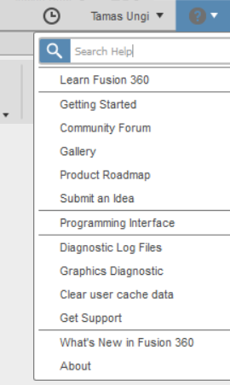
Autodesk Fusion 360
Download for free after registering an account with your university email address
Introductory tutorials can be completed in about 20 hours
Find lots of text/video help on Google for any specific problem

Slide 13
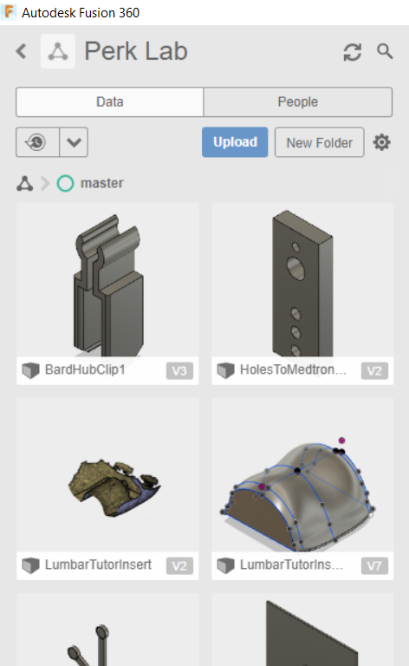
Integrated data repository
Send your account email to ungi@queensu.ca to receive invitation to Perk Lab repository
With every save, you create a new version with a message
All versions are tracked with date, time, user, message
Export published versions using File / Export… menu in .f3d format

Slide 14
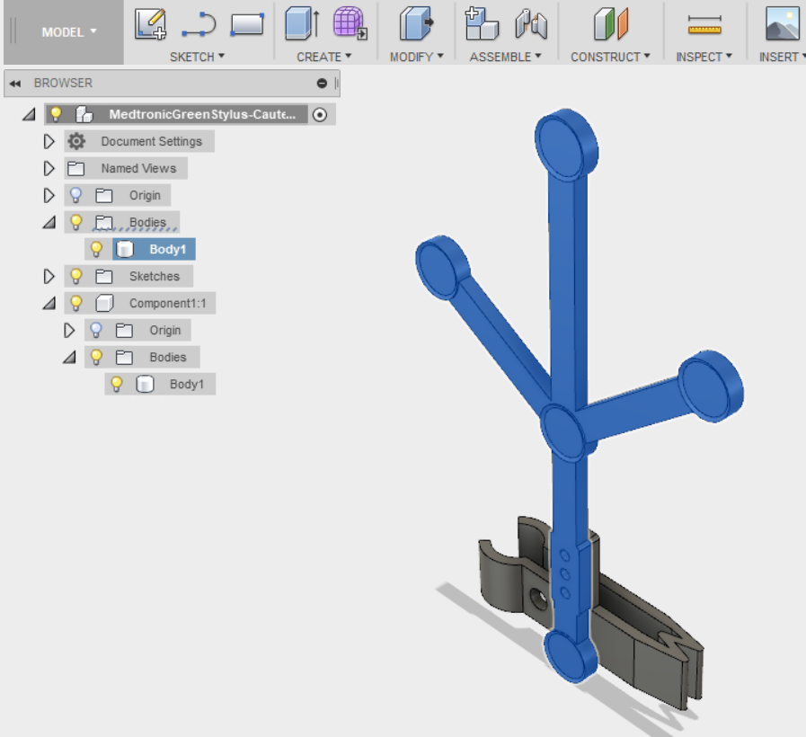
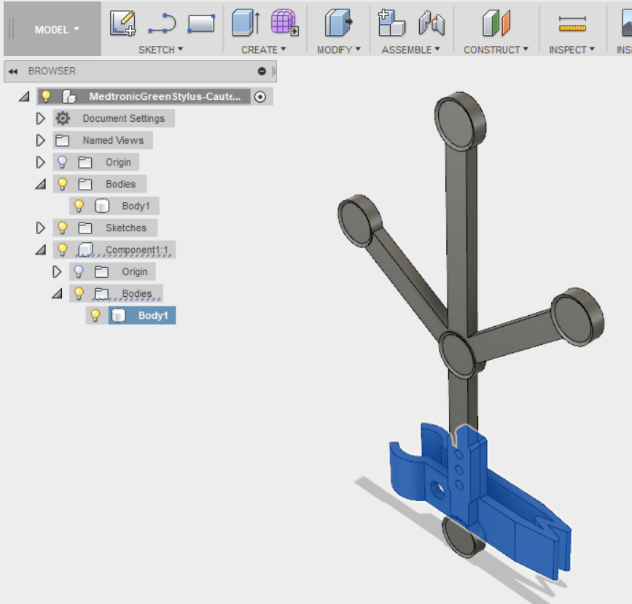
Components and bodies

Slide 15
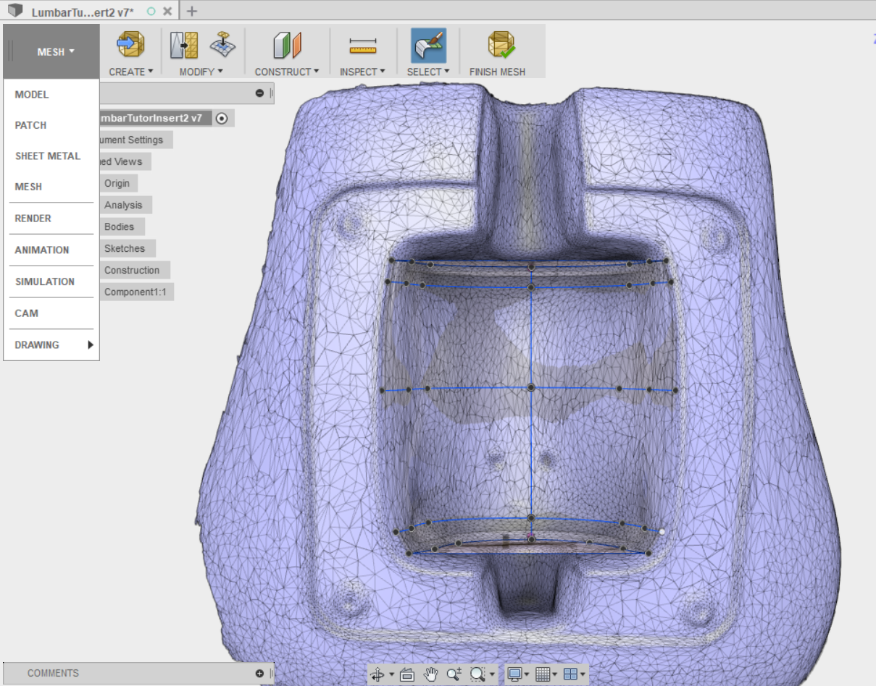
Different workspaces
Drop down

Slide 16
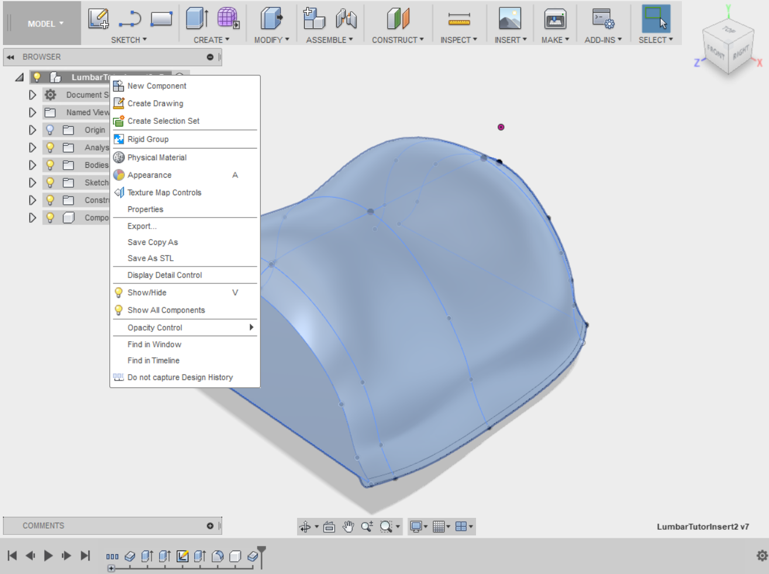
Capture or not – design history
Right-click component
Reduce design complexity during sculpting
Make multiple sketches available to each other for references
select
check

Slide 17
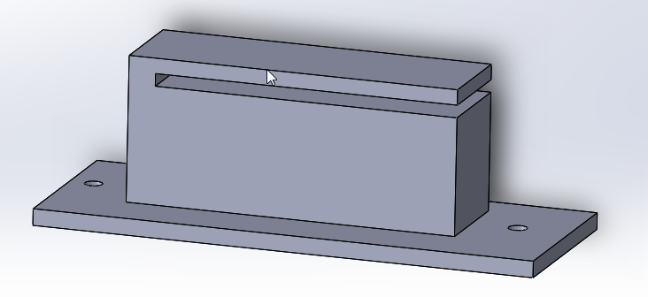
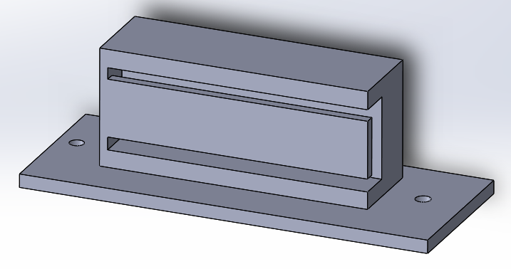
Layer separation
Layers are strong but they are relatively easy to separate: important for thin and long parts
Which of these is going to break?

Slide 18
Video: Toshiba clip design Live demo: - Sensor clip, reuse in other - Skull template

